Slide 1
Practical Coding Series

Slide 2
Schedule
Mar 3 | Ammar | Python packages
April 7 | Batuhan | Optimizing for performance/speed (matlab, python)
May 5 | Rohit | Github workflow
June 2 | Shaina | Personal Web dev
July 7 | Amber | TensorFlow

Slide 3

Note: this session is being recorded

Slide 4
Logistics
All materials will be available afterwards on Github
Please feel free to interrupt, intended to be interactive
We are catering to many levels, so if you have further questions afterward feel free to contact us

Slide 5

Python Packages
Ammar Tareen
CSHL
03/03/2021

Slide 6
Bug Fixing in a Production Environment

Slide 7
Software Development Life Cycle
Python Modules vs. Packages
Documentation
Testing: Unit and Functional Tests
PyPI, Virtual Environments, and Continuous Integration

Slide 8
Software Development Life Cycle (SDLC)
Design
Prototype
Software
Development
Planning
Testing
Deployment
Maintenance,
Monitoring

Slide 9
Software Development Life Cycle
Python Modules vs. Packages
Documentation
Testing: Unit and Functional Tests
PyPI, Virtual Environments, and Continuous Integration

Slide 10
Why Package Your Code?
Avoid huge spaghetti scripts
Want our code to be useful for other scientists/broader audience.
Packaging your code helps facilitate modular programming:
Maintainability: self-contained modules are easier to maintain
Simplicity: fix small/isolated problems at a time
Reusability: modularizing eliminates the need to duplicate code

Slide 11
Python Modules vs. Packages: Modules
File, script, and module are used interchangeably, but have slight differences:
File: a Python file is any file that contains python code. Most python files have .py extensions
Script: a Python script is a file that you intend to execute from the command line
Module: a Python module is a file that you intend to import from within another module or a script or an interactive interpreter.

Slide 12
Three types of modules
A module can be written in python
A module can be written in C and dynamically loaded at runtime (e.g. like the re module)
A module can be built-in to python, like itertools

Slide 13
Module Search Path
Upon import, the interpreter searches for modules in a list compiled from:
Current directory
List of directories in the PYTHONPATH variable
An installation-dependent list configured at the time of python install
Search paths can be obtained/updated from sys.path or os.environ

Slide 14
Python packages
Python packages allow for a hierarchical structuring of module namespaces
You can typically use a _ _ init _ _.py file for package initialization
Sub-packages are contained in sub-directories of packages
Alternately, implicit namespace packages allow for package imports without the init file (Python –V >= 3.3)

Slide 15
Example structure of a Python package
Logomaker/
Logomaker/
_ _ init _ _ .py
code.py
Packages are most often hosted on the Python packaging index (PyPI)
pip install <package name>
Package names can hyphens (e.g. scikit-learn)
Tests/
unit_tests.py
functional_tests.py
run_tests.py
MANIFEST.in
Readme.md
setup.py

Slide 16
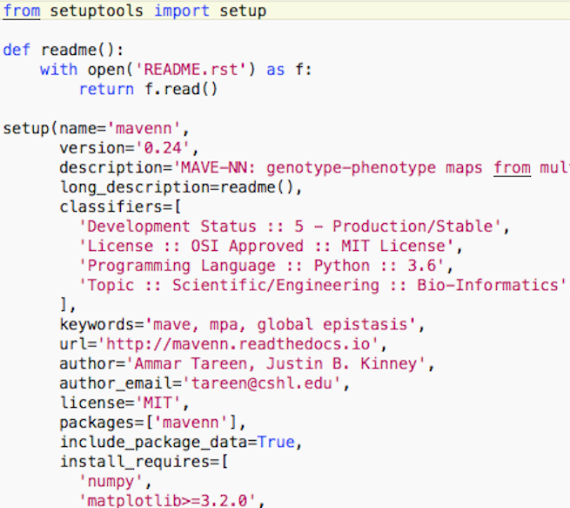
Setting up your package: setup.py
Your package can be setup for distribution using setuptools
Three required variables in setup: 1. name 2. version 3. packages
Package dependencies can be specified by install_requires
Specify package entry script by entry_points

Slide 17
Software Development Life Cycle
Python Modules vs. Packages
Documentation
Testing: Unit and Functional Tests
PyPI, Virtual Environments, and Continuous Integration

Slide 18
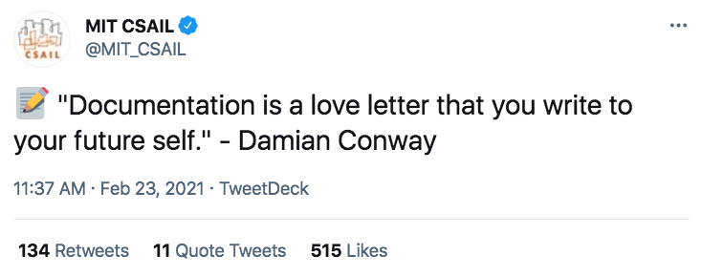
Documentation

Slide 19
Different ways of documentation for Python
Markdown: Display documentation directly on PyPI or Github
reStructedText: use to quickly make webpages or standalone documentation
Sphinx: Documentation generator, multiple formats. Easily links to readthedocs.org
mavenn.readthedocs.org

Slide 20
Sphinx Quickstart
Logomaker/
Logomaker/
_ _ init _ _ .py
pip install Sphinx
sphinx-quickstart
make html
github webhook for readthedocs.org
code.py
Tests/
unit_tests.py
functional_tests.py
run_tests.py
MANIFEST.in
Readme.md
setup.py
Docs/

Slide 21
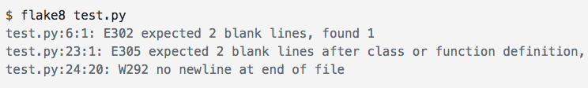
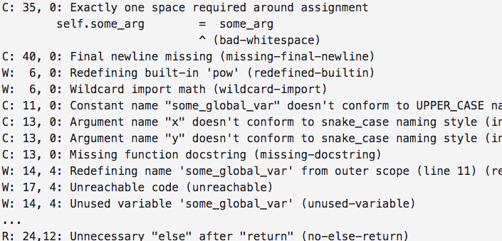
Linters
A linter is a program that will look through your code and give comments, suggest improvements, and predict bugs
Flake8
pylint

Slide 22
Software Development Life Cycle
Python Modules vs. Packages
Documentation
Testing: Unit and Functional Tests
PyPI, Virtual Environments, and Continuous Integration

Slide 23
Testing
Unit tests
Integration/Functional Tests
Tests a single component at a time
Should be written by developer
Tests multiple components at a time
Tester usually not the developer
Test Runners
Test in multiple environments
unittest
nose(2)
pytest
tox
robot

Slide 24
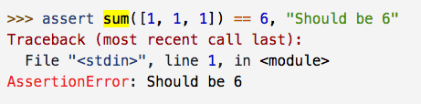
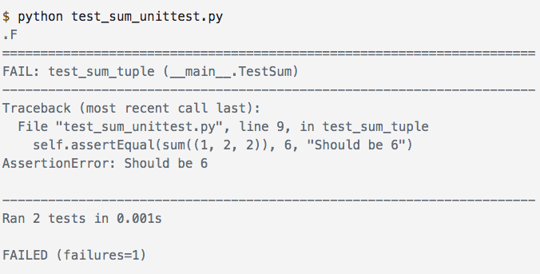
Unit Testing Example
>>> assert sum([1,4,1]) == 6, ‘should be 6’
>>> python -m unittests
import unittest
class TestSum(unittest.TestCase):
def test_sum(self):
self.assertEqual( … )
…

Slide 25
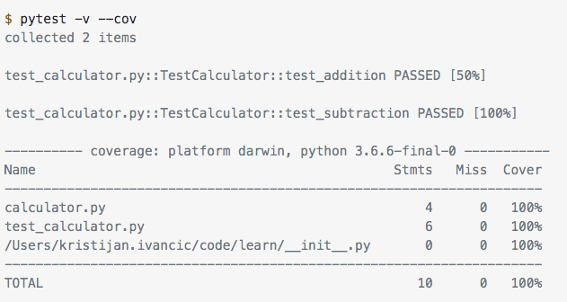
Code Coverage with PyTest
From realpython.com

Slide 26
Nose2 will try to discover all test*.py scripts
Logomaker/
Logomaker/
_ _ init _ _ .py
code.py
Tests/
test_sum.py
>>> python -m nose2
test_another_test.py
>>> python -m unittest discover
MANIFEST.in
Readme.md
setup.py
Docs/

Slide 27
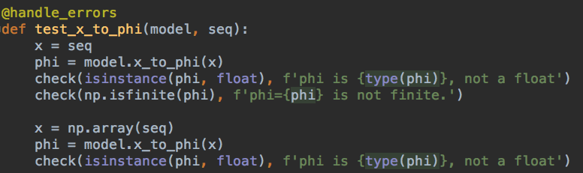
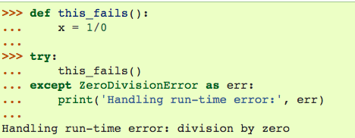
Integration Test Packages
Robot Framework is a popular package for writing integration and functional tests
pyTest also enables integration and functional testing.
Integration Test Example/Demo

Slide 28
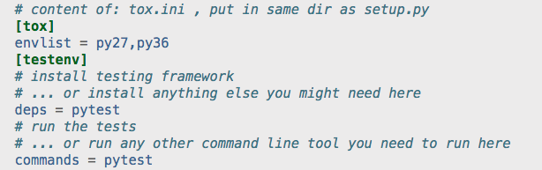
Testing in multiple environments with tox

Slide 29
Software Development Life Cycle
Python Modules vs. Packages
Documentation
Testing: Unit and Functional Tests
PyPI, Virtual Environments, and Continuous Integration

Slide 30
PyPI
The Python Package Index (PyPI) is a repository of software for the Python programming language.
pip install <package name>
Global site packages: python -m site
User site packages: pip freeze --user
pip show <package name>

Slide 31
Package versioning and non-source files for PyPI
PyPI requires package versions to increment with each update
PEP - 440 provides recommends for versioning
E.g.: semantic versioning: # . # . # (Major version, Minor version, Patch/hotfix)
All non source files, e.g., data files, binaries, text files etc, can be specified in your manifest.in file
Specify include_package_data=True in setup.py

Slide 32
Publishing on PyPI
Packages on PyPI are commonly distributed as source archives and wheels
Source archives contain all source code in a single tar file
Wheels are ready to use builds
creates .tar
cookiecutter will setup
package structure
>>> python setup.py sdist bdist_wheel
creates .whl
>>> twine -r upload pypi dist/*
Uploads package on PyPI

Slide 33
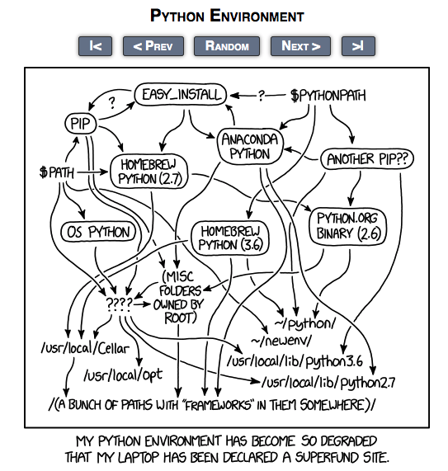

Slide 34
Virtual Environments
Virtual environments can circumvent dependency conflicts between packages
Virtual environments can be updated in an package specific manner
Virtual environments can shield against global site-packages and system wide python install conflicts
Many popular virtual environment options …
venv
virtualenv
conda create …
pyenv

Slide 35
Two Virtual Environment Examples
Virtualenv
>>> virtualenv -p /usr/bin/python my_virtual_env
>>> source my_virtual_env/bin/activate
Conda
>>> conda create --name my_conda_env python=3.9.2
>>> conda activate my_conda_env

Slide 36
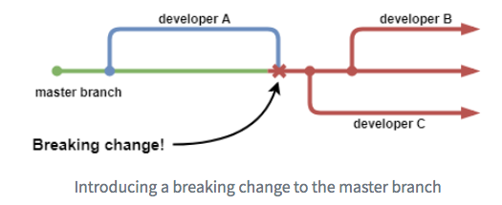
Continuous Integration
Continuous Integration is a software development practice where members of a team integrate their work
frequently, usually each person integrates at least daily - leading to multiple integrations per day. Each
integration is verified by an automated build (including test) to detect integration errors as quickly as possible.

Slide 37
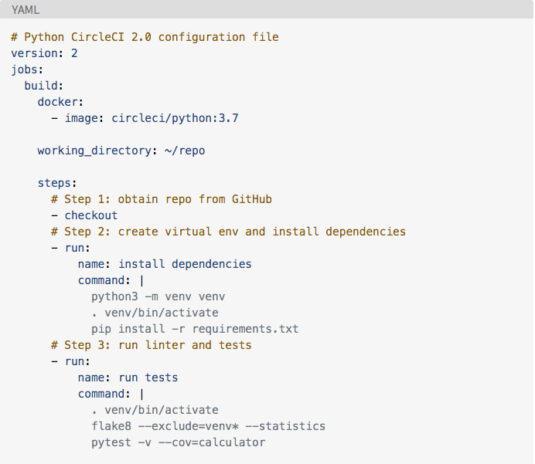
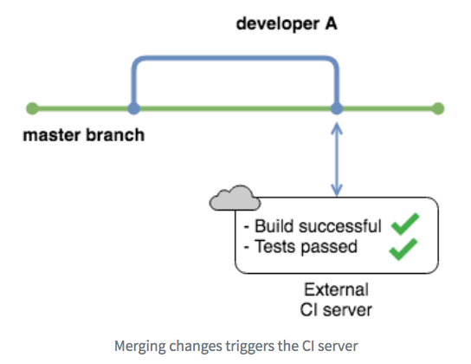
Automating Builds/Tests

Slide 38
Putting things together
Logomaker/
Logomaker/
>>> python setup.py sdist bdist_wheel
>>> virtualenv test_local_build
>>> source test_local_build/bin/activate
>>> pip install dist/<package_name>.tar.gz
# run tests …
>>> twine upload -r pypi dist/<package_name>.*
code.py
Tests/
Integration_Tests/
Unit_Tests/
MANIFEST.in
Readme.md
setup.py
Docs/

Slide 39
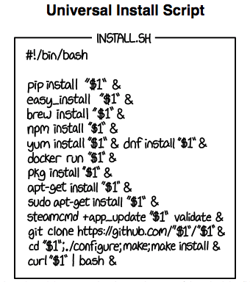
Questions?
https://packaging.python.org/
mavenn.readthedocs.org
logomaker.readthedocs.org
suftware.readthedocs.org
Some resources taken from realpython

